Slide 1
EnerTrac Baseline Forecast for DCAS 1 Centre St. (1st Iteration)
Naili Ding
May 2020

Slide 2
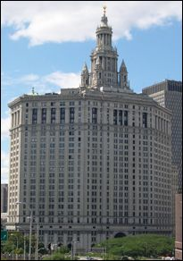
Baseline Prediction
What is energy baseline?
An energy baseline is a reference tool, which allows the user to compare energy performance before and after a change is made to the user’s site or system
Major challenges of establishing a baseline
Identify the driving factors
Capture the underlying pattern using machine learning models
Evaluate the performance of the model
Scalability
Municipal building at 1 Centre St.

Slide 3
Objective
Develop a roadmap and strategies to systematically convert raw energy data into useful insights (≠ automation)
Provide documentation for the methodologies, including machine learning concepts, programming packages, Python code etc.
Implement the proposed methodologies in Python using the EnerTrac data of 1 Centre St.
Develop an interactive data visualization tool
Deliverable: an all-in-one Jupyter notebook + project folder mounted in shared Google Drive

Slide 4
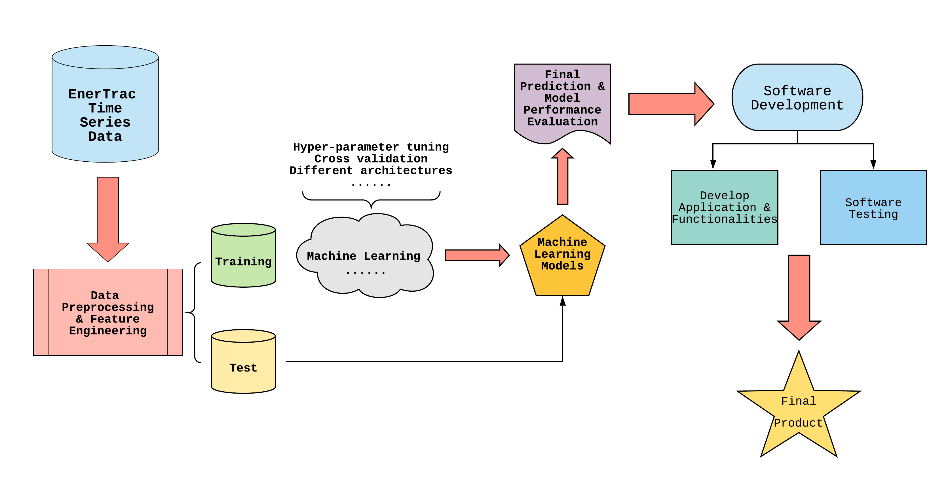
Project Lifecycle

Slide 5
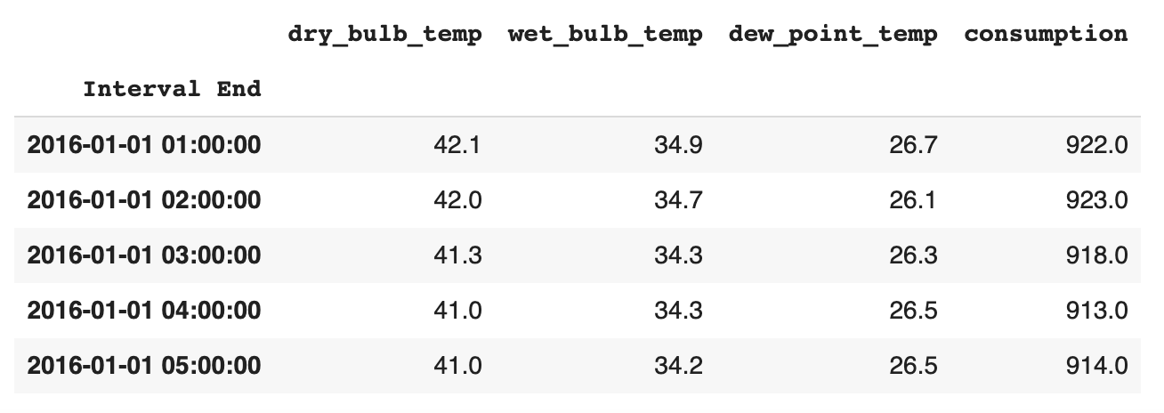
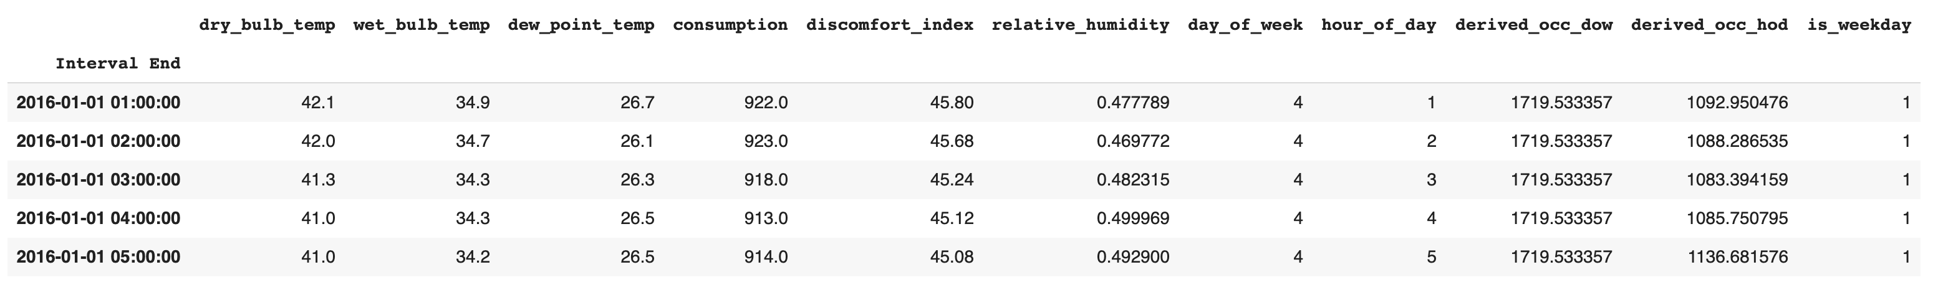
Data Preprocessing
One-hour interval data from EnerTrac
Original inputs: weather data
Target: energy consumption
Feature engineering

Slide 6
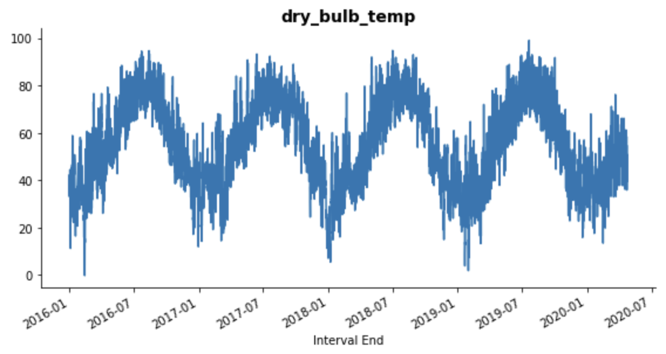
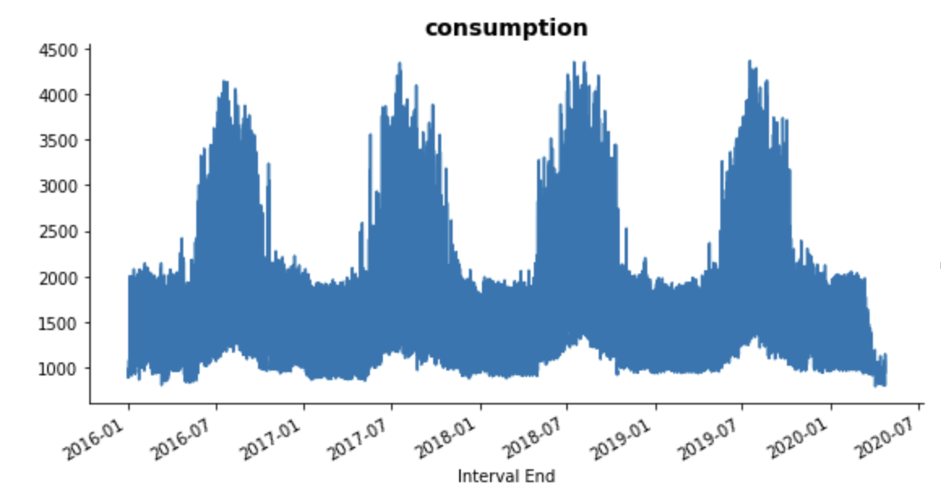
Exploratory Data Analysis
Outside Air Temperature (F)
Energy Consumption (kW)

Slide 7
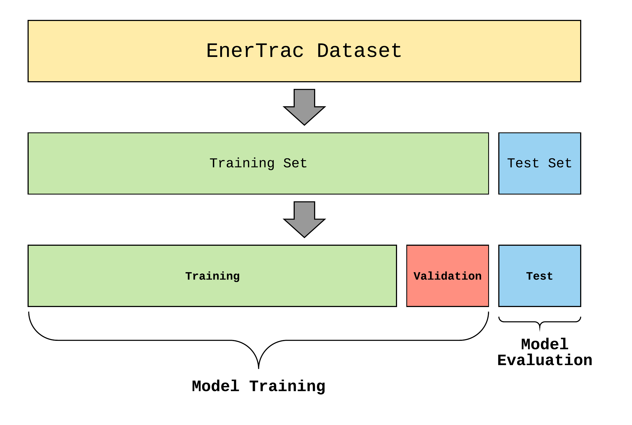
Train-test split
4-year time series data
1-hour resolution
Total data size: 37,681
Training size: 30,512
Validation size: 3,391
Test size: 3,769

Slide 8

Statistical Learning - VAR
VAR stands for Vector Autoregression
It’s a linear system of equations
Need to ensure the stationarity of time series
Data-preprocessing is straightforward
Model training time is fast

Slide 9
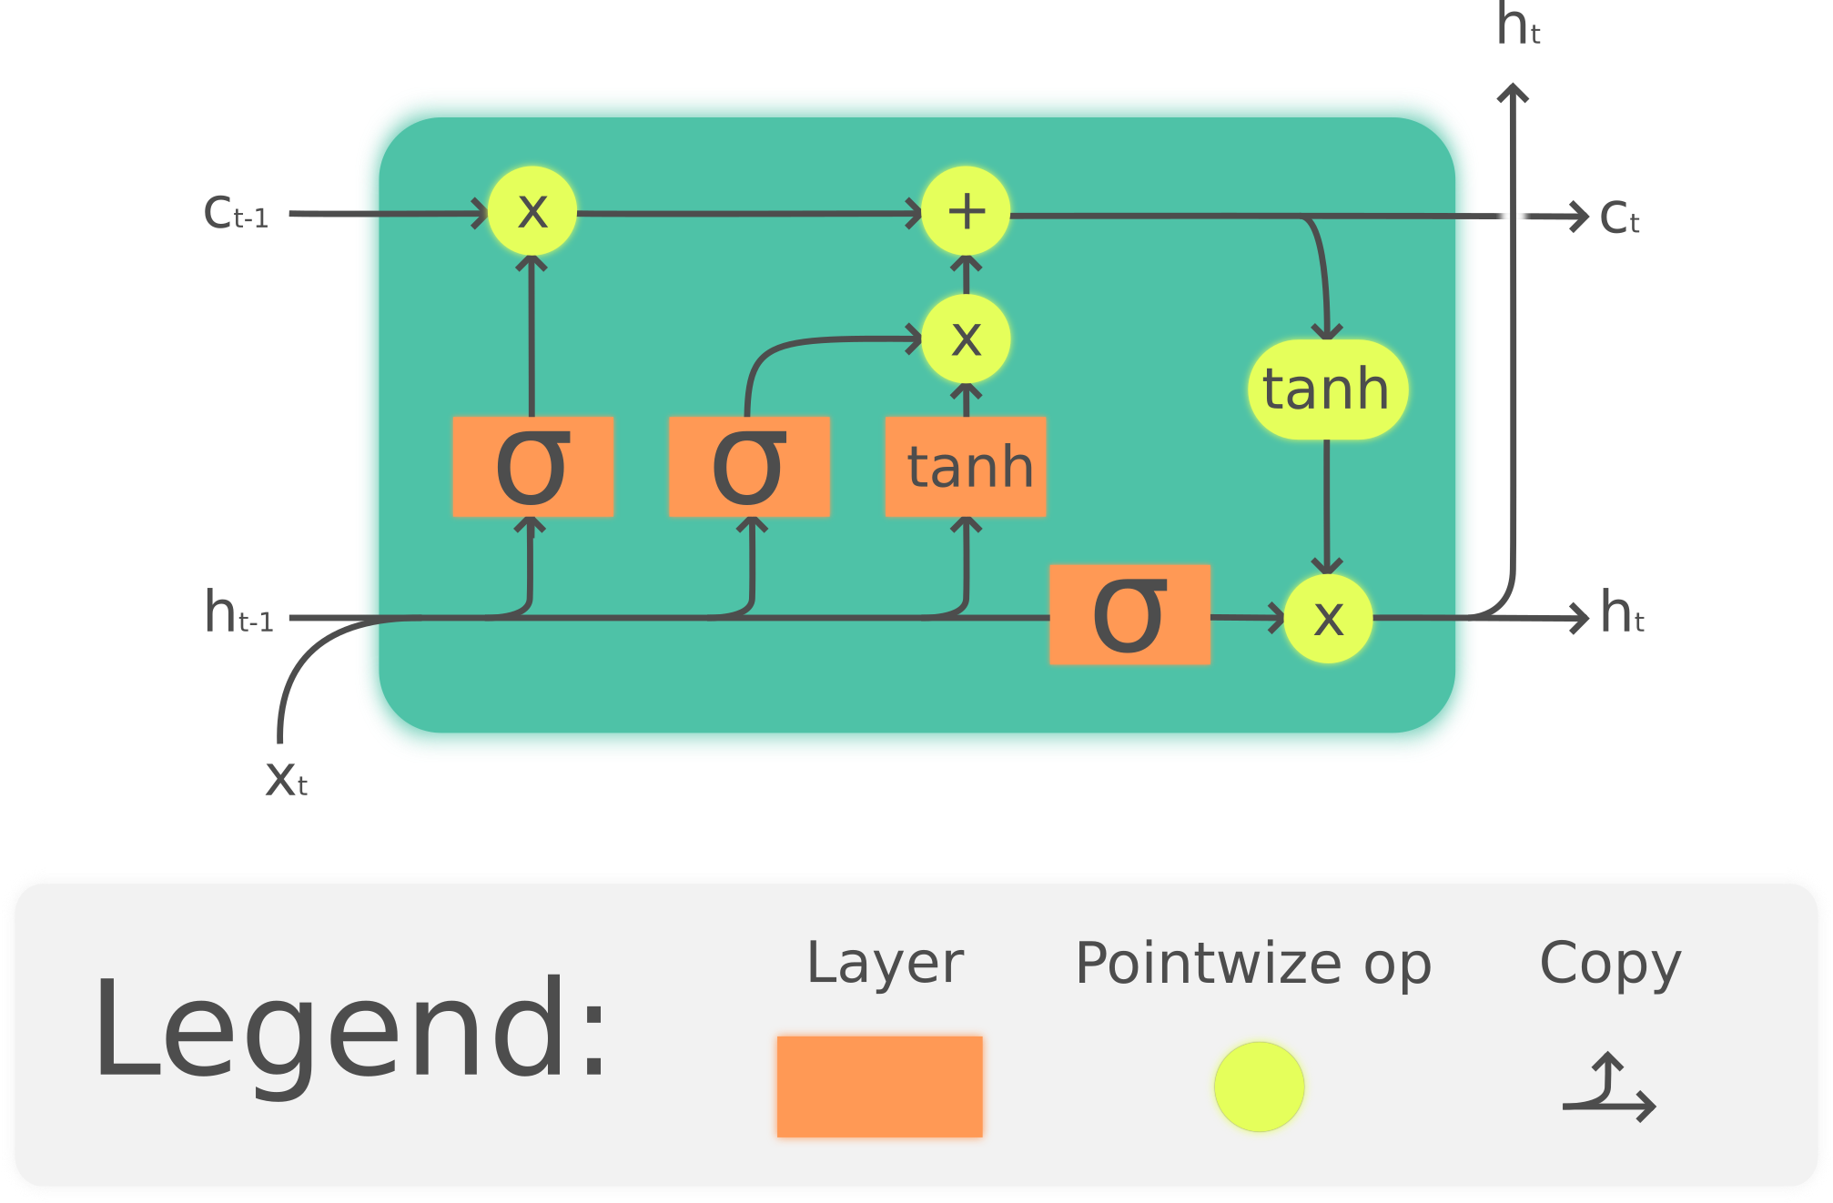
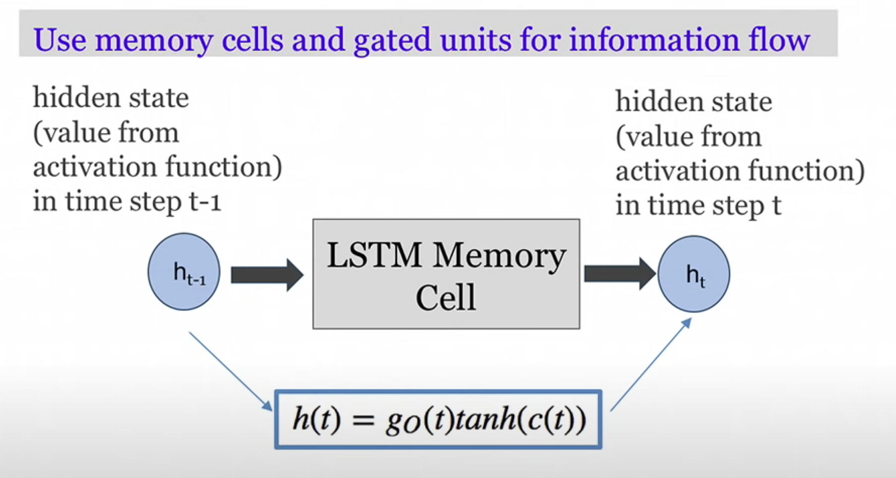
Deep Learning - LSTM
LSTM stands for Long Short-Term Memory
A Recurrent Neural Network (RNN) Architecture used in the field of deep learning
Could be implemented in Keras (simpler version of Tensorflow)

Slide 10
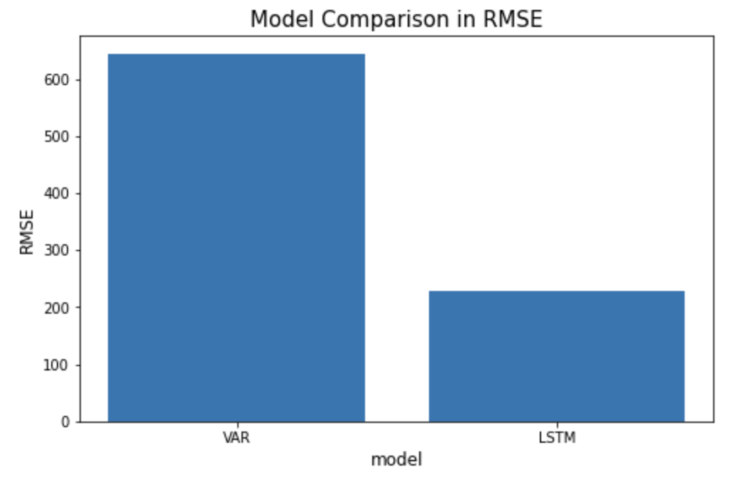
Model Evaluation
RMSE (LSTM): 228
RMSE (VAR): 644

Slide 11
Model Comparison
VAR | LSTM
Macroeconomic time series Financial time series Business time series Other numerical series | DNA sequences Images Voice sequences Texts All the numerical time series that could be modeled by VAR

Slide 12
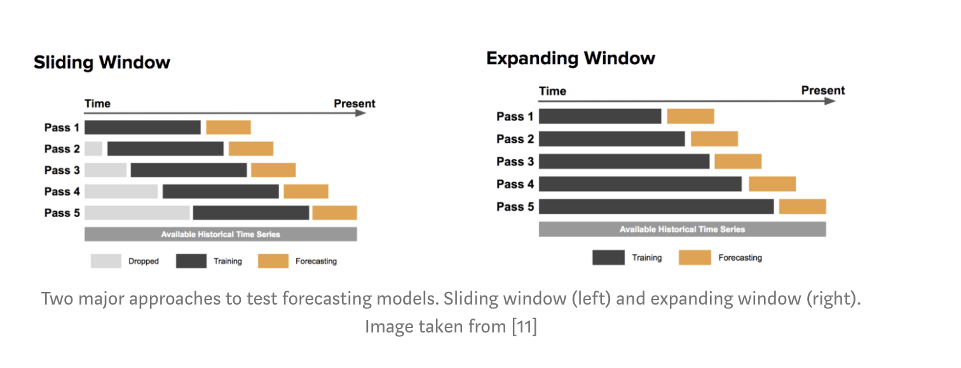
Back-testing
Use back-testing to update your model & re-evaluate your model periodically
When testing high-frequency data such as daily and hourly time series, it’s better to use rolling window back-testing
Otherwise, if the historical data of time series is limited to weekly, monthly or quarterly, the expanding window works better

Slide 13
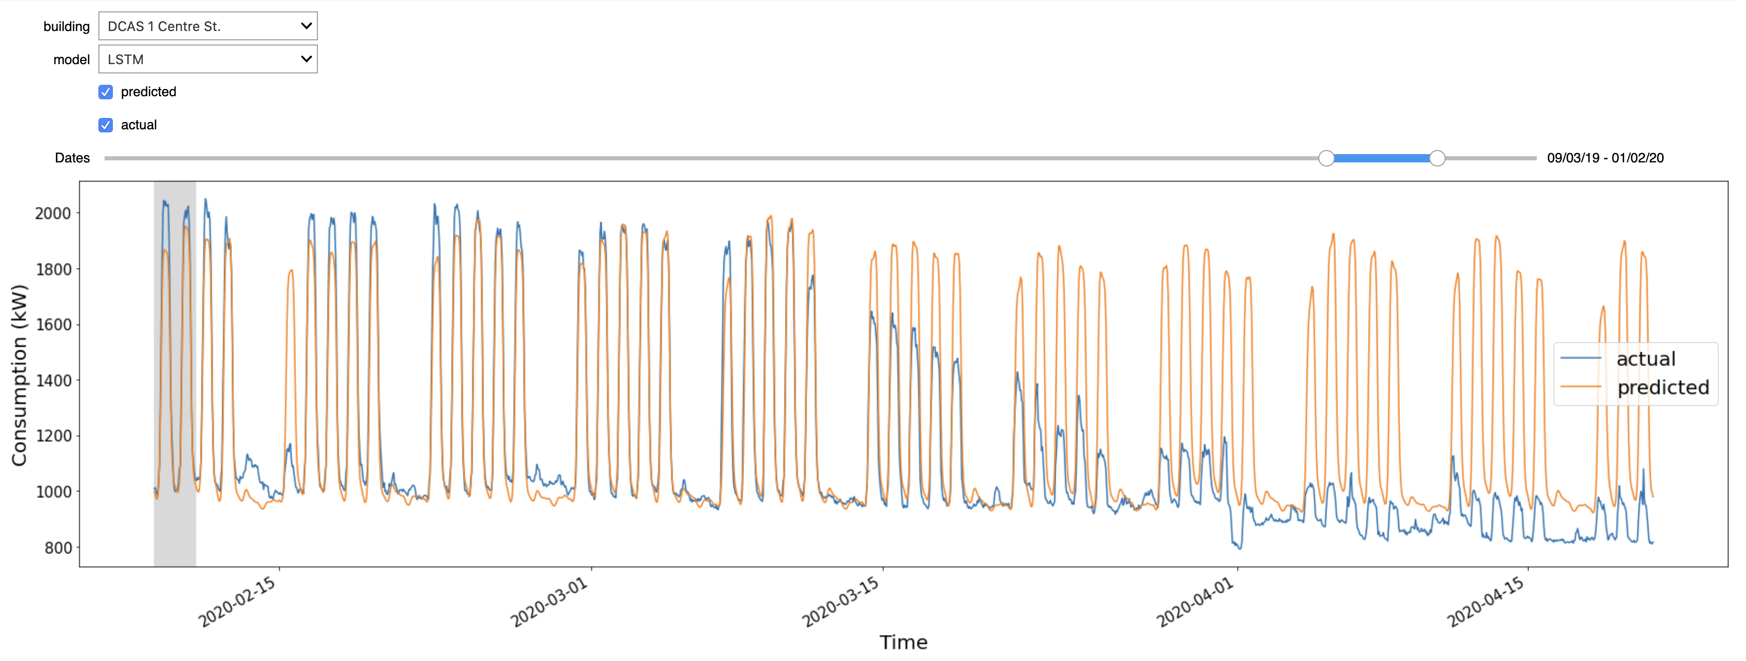
Demo!

Slide 14
Possible Next Steps
Hyper-parameter tuning for the existing LSTM model (for now, it’s the simplest architecture)
Implement another model or two, for example, Support Vector Machine (SVM), Quantile Regression, ARIMA etc.
Make the existing interactive tool more robust and more functional
More documentation & refinement of the notebook

Slide 15
EnerTrac Baseline Forecast for DCAS 1 Centre St. (2nd Iteration)
Naili Ding
May 2020

Slide 16
Objective
Develop additional features for machine learning
Implement new machine learning models, such as Support Vector Machine, Quantile Regression Trees etc.
Hyper-parameter tuning for the machine learning models
Apply the same methodologies to a new building, Q263
Incorporate the results for the new models and the new building into the interactive tool
Deliverable: an all-in-one Jupyter notebook + project folder mounted in shared Google Drive

Slide 17
Project Lifecycle
New Development

Slide 18
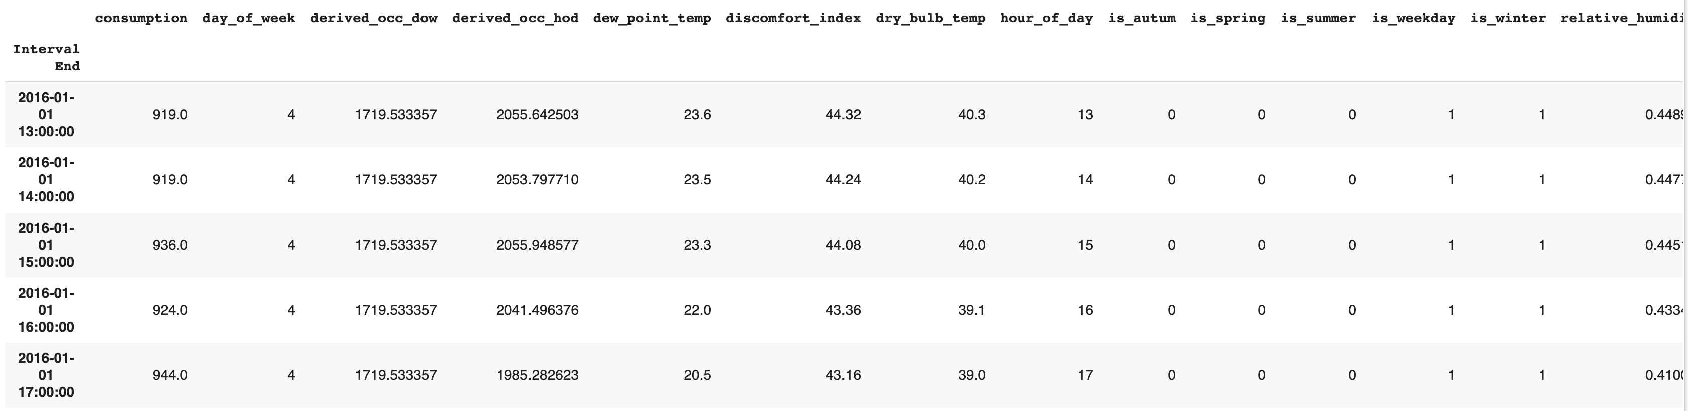
Additional Features
Binary feature to indicate seasonality and holidays (0 or 1):
is_summer
is_winter
is_autumn
is_spring
is_holiday
Building thermal mass (OAT Values before time t):
thermal_mass_3
thermal_mass_5
thermal_mass_7
thermal_mass_12
4 features -> 19 features

Slide 19
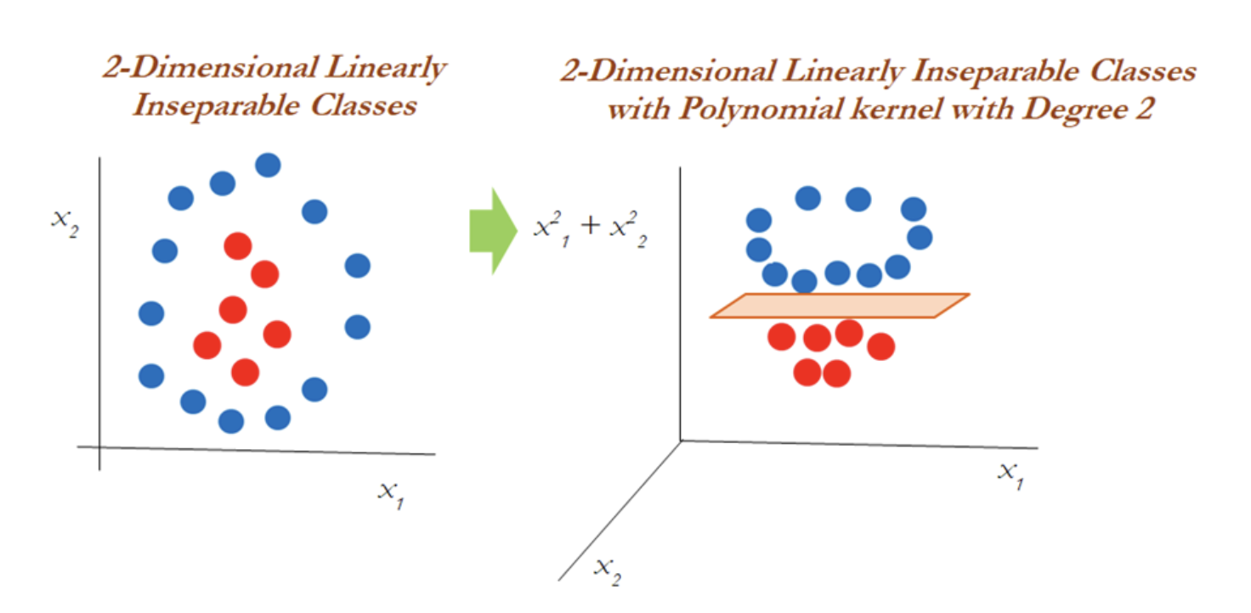
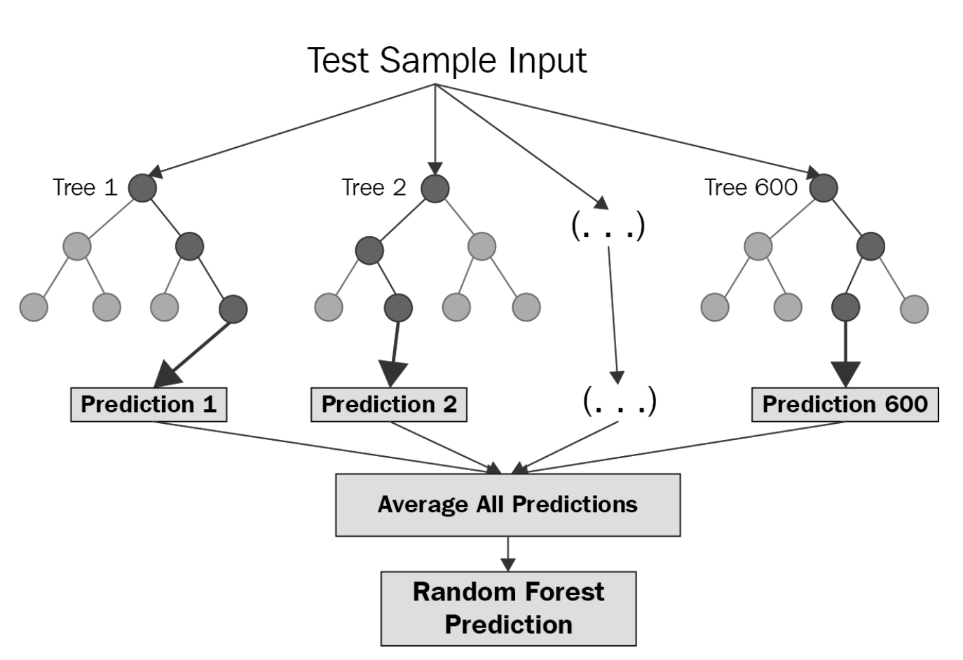
New Machine Learning Models
Support Vector Machine
Random Forests
https://hub.packtpub.com/what-is-a-support-vector-machine/
https://towardsdatascience.com/random-forest-and-its-implementation-71824ced454f

Slide 20
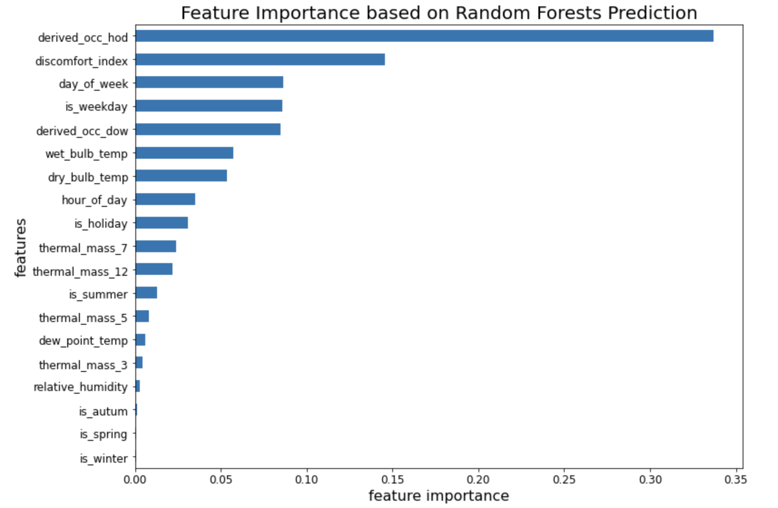
Feature Importance
𝐷𝐼 = 0.4(𝑡_{𝑑}+𝑡_{𝑤})+15

Slide 21
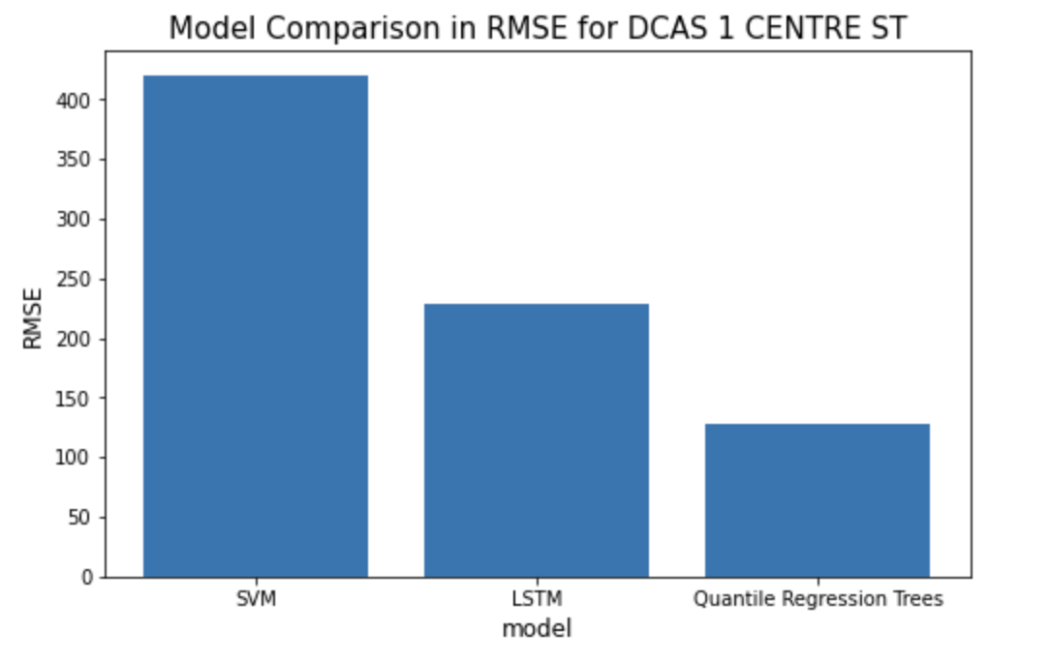
Model Comparison for 1 Centre St.
LSTM: 229
SVM: 518
Quantile Regression Trees: 128

Slide 22
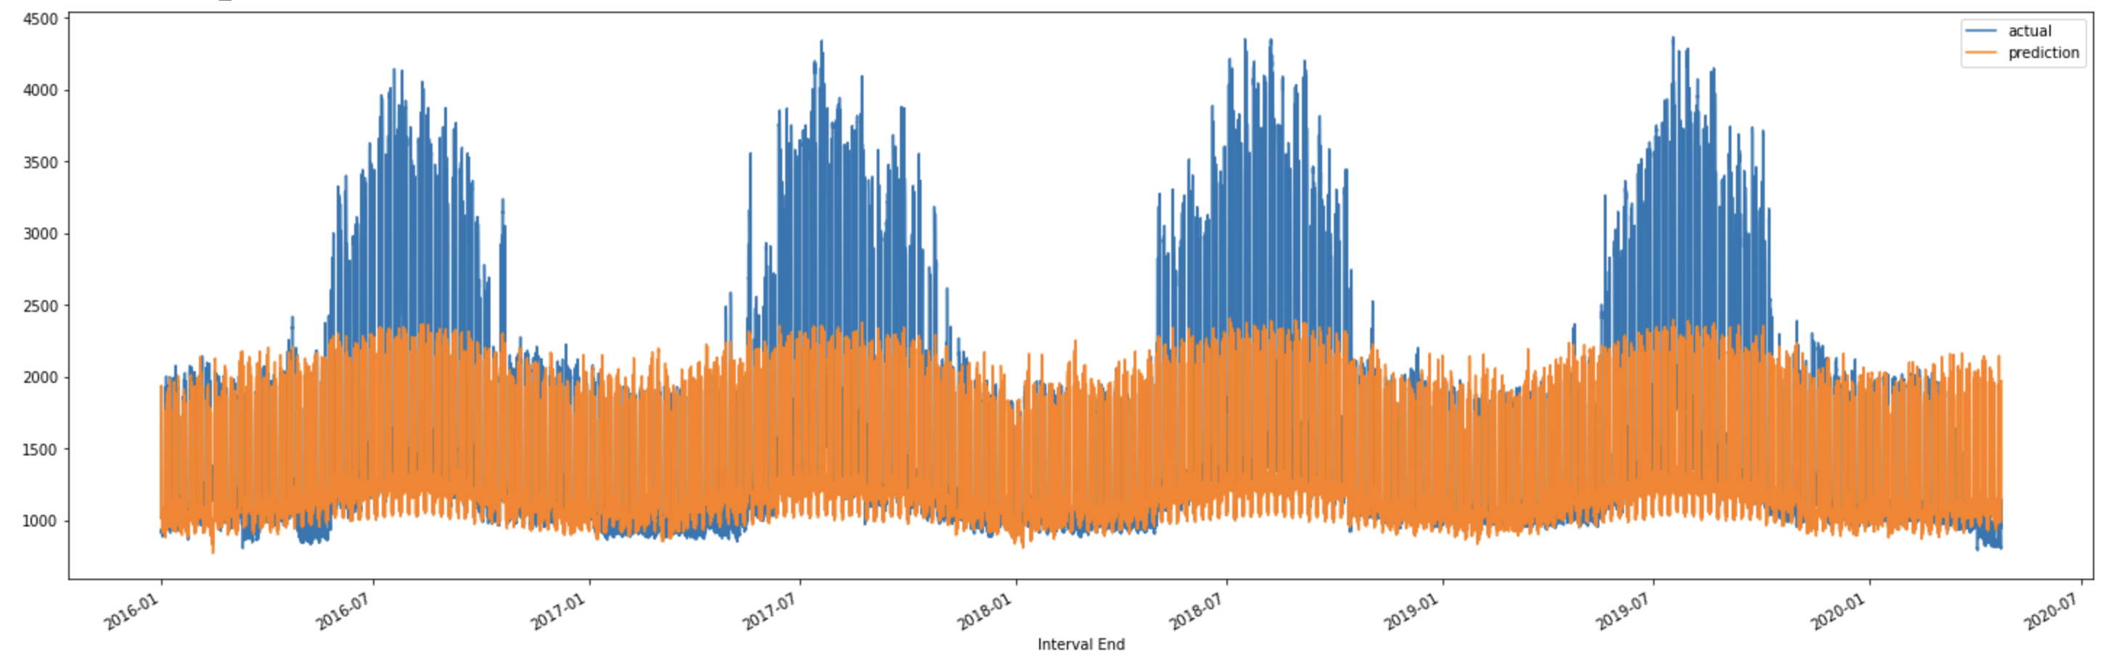
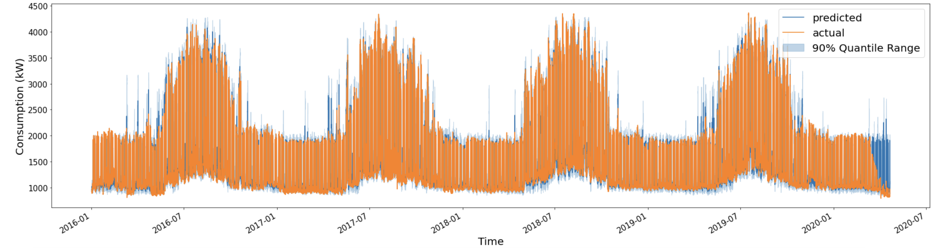
Model Comparison for 1 Center St.
SVM
Quantile Regression Trees

Slide 23
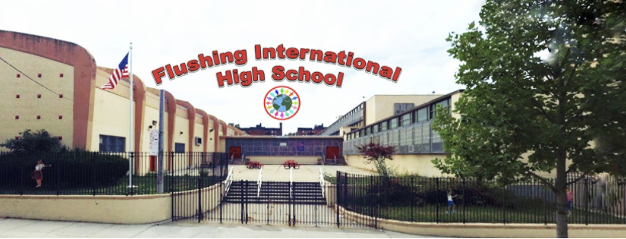
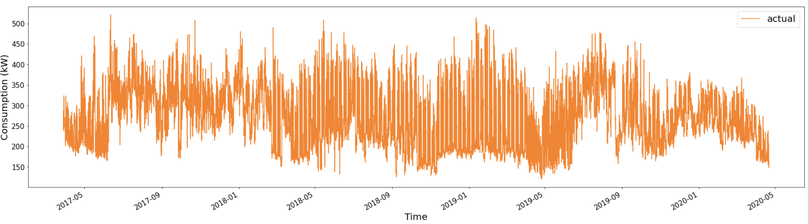
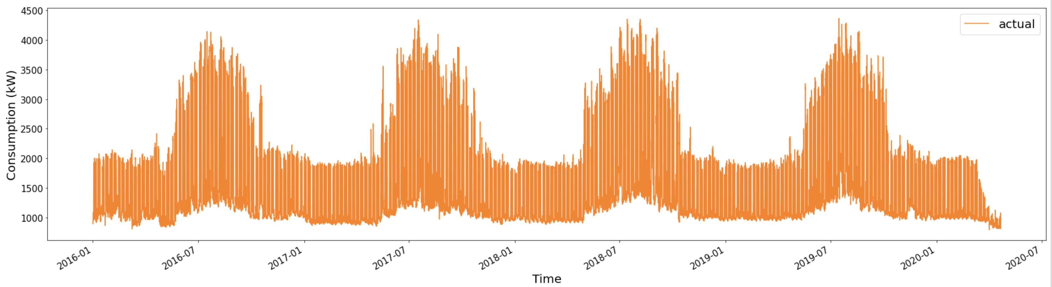
Q263 Flushing International High School

Slide 24
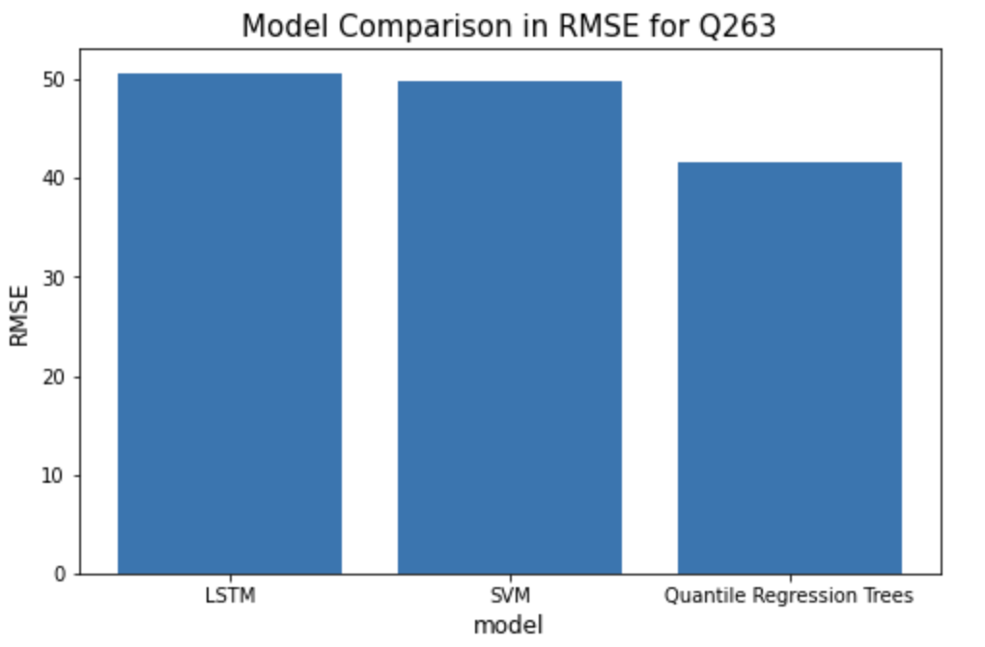
Model Comparison for Q263
LSTM: 51
SVM: 49
Quantile Regression Trees: 47

Slide 25
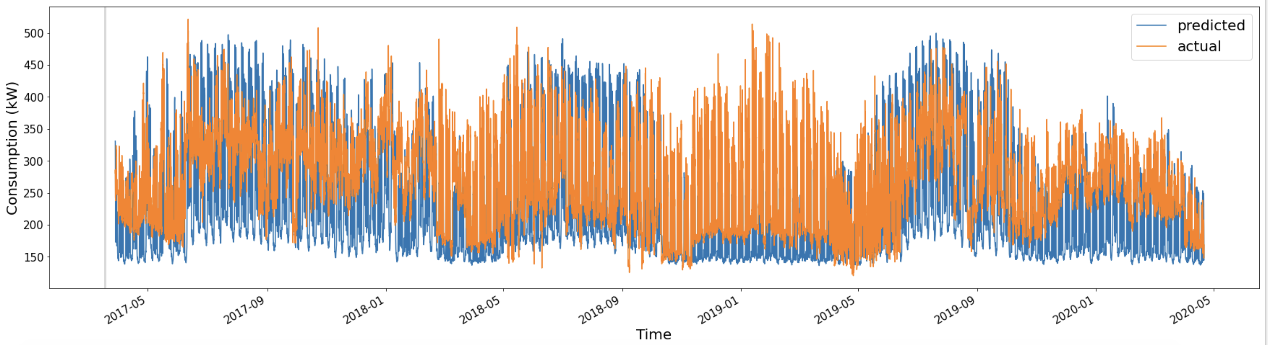
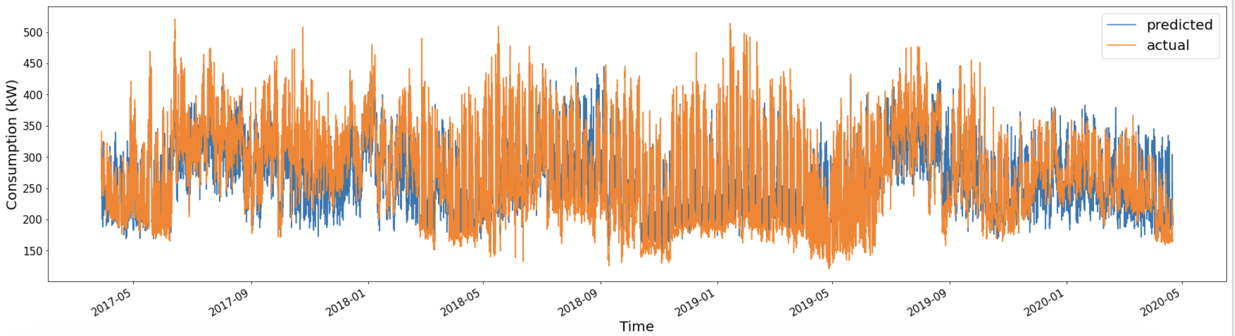
Model Comparison for Q263
LSTM
Quantile Regression Trees

Slide 26
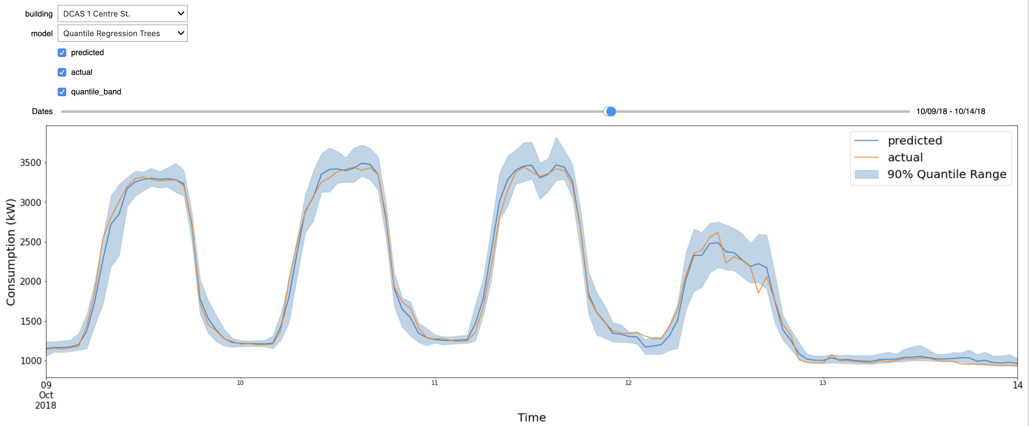
Demo Upgrade

Slide 27
Next Steps
Clean up the code & put the existing code into a module
Investigate possible issues with SVM predictions (Seasonality? Input variables?)
Replicate the methodologies for other buildings
Monitoring / anomaly detection using Quantile Regression Trees

